Slide 1
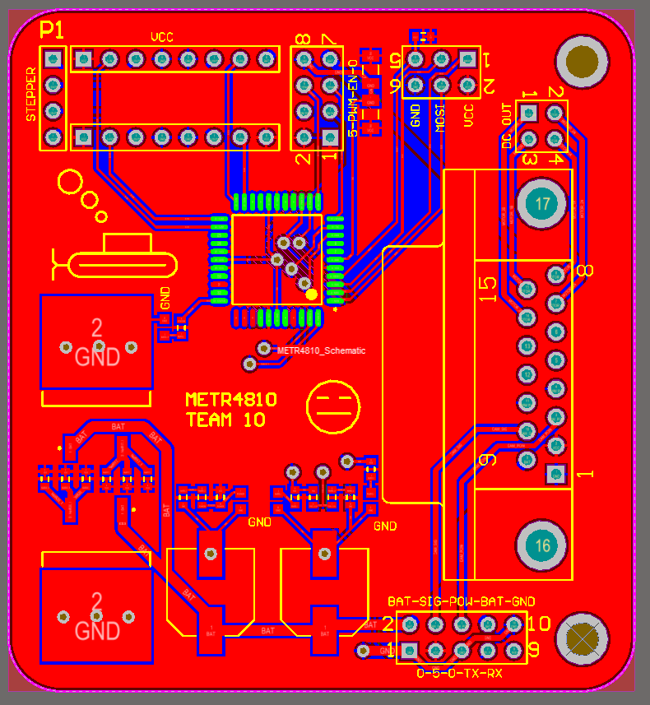
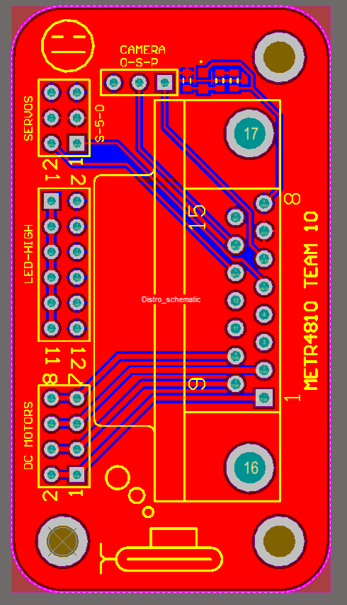
1x4 female
1x8 female
1x8 female
2x4 female
2x3 male
2x2 female
2xVreg
2xCap L
2xCap S
324
2x5 female
DB Connector
6x1 ohm
1x10k ohm
8x1k ohm
4x LED
1x L293D
2x4 female
2x6 female
2x4 female
1x3 female
DB connector

